Slide 1
Eigenvalues and Eigenvectors
EIGENVECTORS AND EIGENVALUES

Slide 2
EIGENVECTORS AND EIGENVALUES
Definition: An eigenvector of an matrix A is a nonzero vector x such that for some scalar λ. A scalar λ is called an eigenvalue of A if there is a nontrivial solution x of ; such an x is called an eigenvector corresponding to λ.
λ is an eigenvalue of an matrix A if and only if the equation
(1)
has a nontrivial solution.
The set of all solutions of (1) is just the null space of the matrix .

Slide 3

EIGENVECTORS AND EIGENVALUES
So this set is a subspace of and is called the eigenspace of A corresponding to λ.
The eigenspace consists of the zero vector and all the eigenvectors corresponding to λ.
Example 1: Show that 7 is an eigenvalue of matrix
and find the corresponding eigenvectors.
$$ℝ^{n}$$

Slide 4
EIGENVECTORS AND EIGENVALUES
Solution: The scalar 7 is an eigenvalue of A if and only if the equation
(2)
has a nontrivial solution.
But (2) is equivalent to , or
(3)
To solve this homogeneous equation, form the matrix

Slide 5
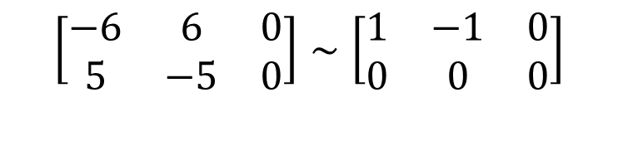
EIGENVECTORS AND EIGENVALUES
The columns of are obviously linearly dependent, so (3) has nontrivial solutions.
To find the corresponding eigenvectors, use row operations:
The general solution has the form .
Each vector of this form with is an eigenvector corresponding to .
$$\left[\begin{matrix}−6 & 6 & 0 \\ 5 & −5 & 0\end{matrix}\right]∼\left[\begin{matrix}1 & −1 & 0 \\ 0 & 0 & 0\end{matrix}\right]$$

Slide 6
EIGENVECTORS AND EIGENVALUES
Example 2: Let . An eigenvalue of
A is 2. Find a basis for the corresponding eigenspace.
Solution: Form
and row reduce the augmented matrix for .

Slide 7
EIGENVECTORS AND EIGENVALUES
At this point, it is clear that 2 is indeed an eigenvalue of A because the equation has free variables.
The general solution is
, x₂ and x₃ free.

Slide 8
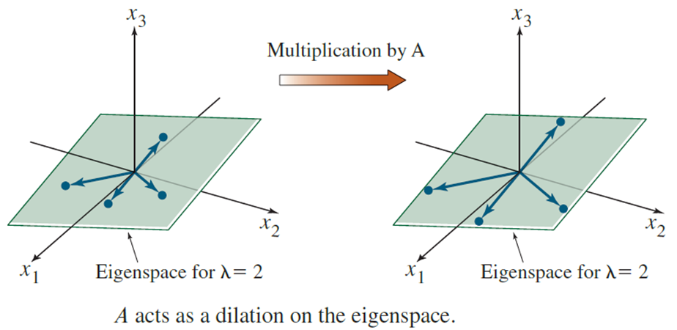

EIGENVECTORS AND EIGENVALUES
The eigenspace, shown in the following figure, is a two-dimensional subspace of .
A basis is
$$ℝ^{3}$$

Slide 9
EIGENVECTORS AND EIGENVALUES
Theorem 1: The eigenvalues of a triangular matrix are the entries on its main diagonal.
Proof: For simplicity, consider the case.
If A is upper triangular, the has the form

Slide 10
EIGENVECTORS AND EIGENVALUES
The scalar λ is an eigenvalue of A if and only if the equation has a nontrivial solution, that is, if and only if the equation has a free variable.
Because of the zero entries in , it is easy to see that has a free variable if and only if at least one of the entries on the diagonal of is zero.
This happens if and only if λ equals one of the entries a₁₁, a₂₂, a₃₃ in A.

Slide 11
EIGENVECTORS AND EIGENVALUES
Theorem 2: If v₁, …, v_{r} are eigenvectors that correspond to distinct eigenvalues λ₁, …, λ_{r} of an
matrix A, then the set {v₁, …, v_{r}} is linearly independent.
Proof: Suppose {v₁, …, v_{r}} is linearly dependent.
Since v₁ is nonzero, Theorem 7 in Section 1.7 says that one of the vectors in the set is a linear combination of the preceding vectors.
Let p be the least index such that is a linear combination of the preceding (linearly independent) vectors.

Slide 12
EIGENVECTORS AND EIGENVALUES
Then there exist scalars c₁, …, c_{p} such that
(4)
Multiplying both sides of (4) by A and using the fact that
(5)
Multiplying both sides of (4) by and subtracting the result from (5), we have
(6)

Slide 13
EIGENVECTORS AND EIGENVALUES
Since {v₁, …, v_{p}} is linearly independent, the weights in (6) are all zero.
But none of the factors are zero, because the eigenvalues are distinct.
Hence for .
But then (4) says that , which is impossible.

Slide 14
EIGENVECTORS AND DIFFERENCE EQUATIONS
Hence {v₁, …, v_{r}} cannot be linearly dependent and therefore must be linearly independent.

